Slide 1



SLOVAK UNIVERSITY OF TECHNOLOGY IN BRATISLAVA
INSTITUTE OF MEASUREMENT SCIENCE OF THE SLOVAK ACADEMY OF SCIENCES
INSTITUTE OF ELECTRICAL ENGINEERING
Dissertation thesis
DEVELOPMENT OF A METHODOLOGY AND PLATFORM FOR THE MEASUREMENT OF LOW-FREQUENCY MAGNETIC FIELD BIOLOGICAL EFFECTS
Author: Ing. Hoang Vu Viet
Supervisor: Mgr. Michal Teplan, PhD.
Consultant: Mgr. Ľubomir Kremnický, PhD.

Slide 2
Content
Introduction
Previous Researches
Measurement Platform
Cell Concentration Monitoring Based on Impedance Spectroscopy
Static Cultivation with Turbidimetry Based Concentration Measurement
Effect of 50 Hz Magnetic Field on Saccharomyces Cerevisiae
Pulsed Electric Field Effect on Yeast Cells
Conclusions and Main Contributions

Slide 3
Introduction
Low-frequency magnetic fields (LF MFs) are widespread in modern environments and may influence various biological processes including gene expression, cell growth, and oxidative stress, though their effects remain poorly understood.
Scientific studies report both beneficial and harmful effects, including links to diseases (e.g., cancer, neurodegeneration) as well as potential in therapies and biotechnology.
Biological responses vary greatly depending on cell type, exposure parameters, and environmental conditions, highlighting the need for standardized, well controlled experiments.
Proposed interaction mechanisms include ion cyclotron resonance, ion parametric resonance, and the radical pair mechanism but lack consistent experimental validation.
Many past studies lacked methodological rigor, particularly in temperature control, exposure uniformity, and shielding from ambient fields, reducing their credibility.
A new experimental platform with precise magnetic field generation and temperature control, enabling reproducible testing of LF MF effects on yeast growth, and offering a foundation for future scientific and biotechnological applications.

Slide 4
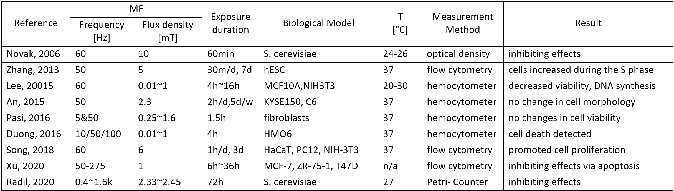
Previous Researches – Biological Effects

Slide 5
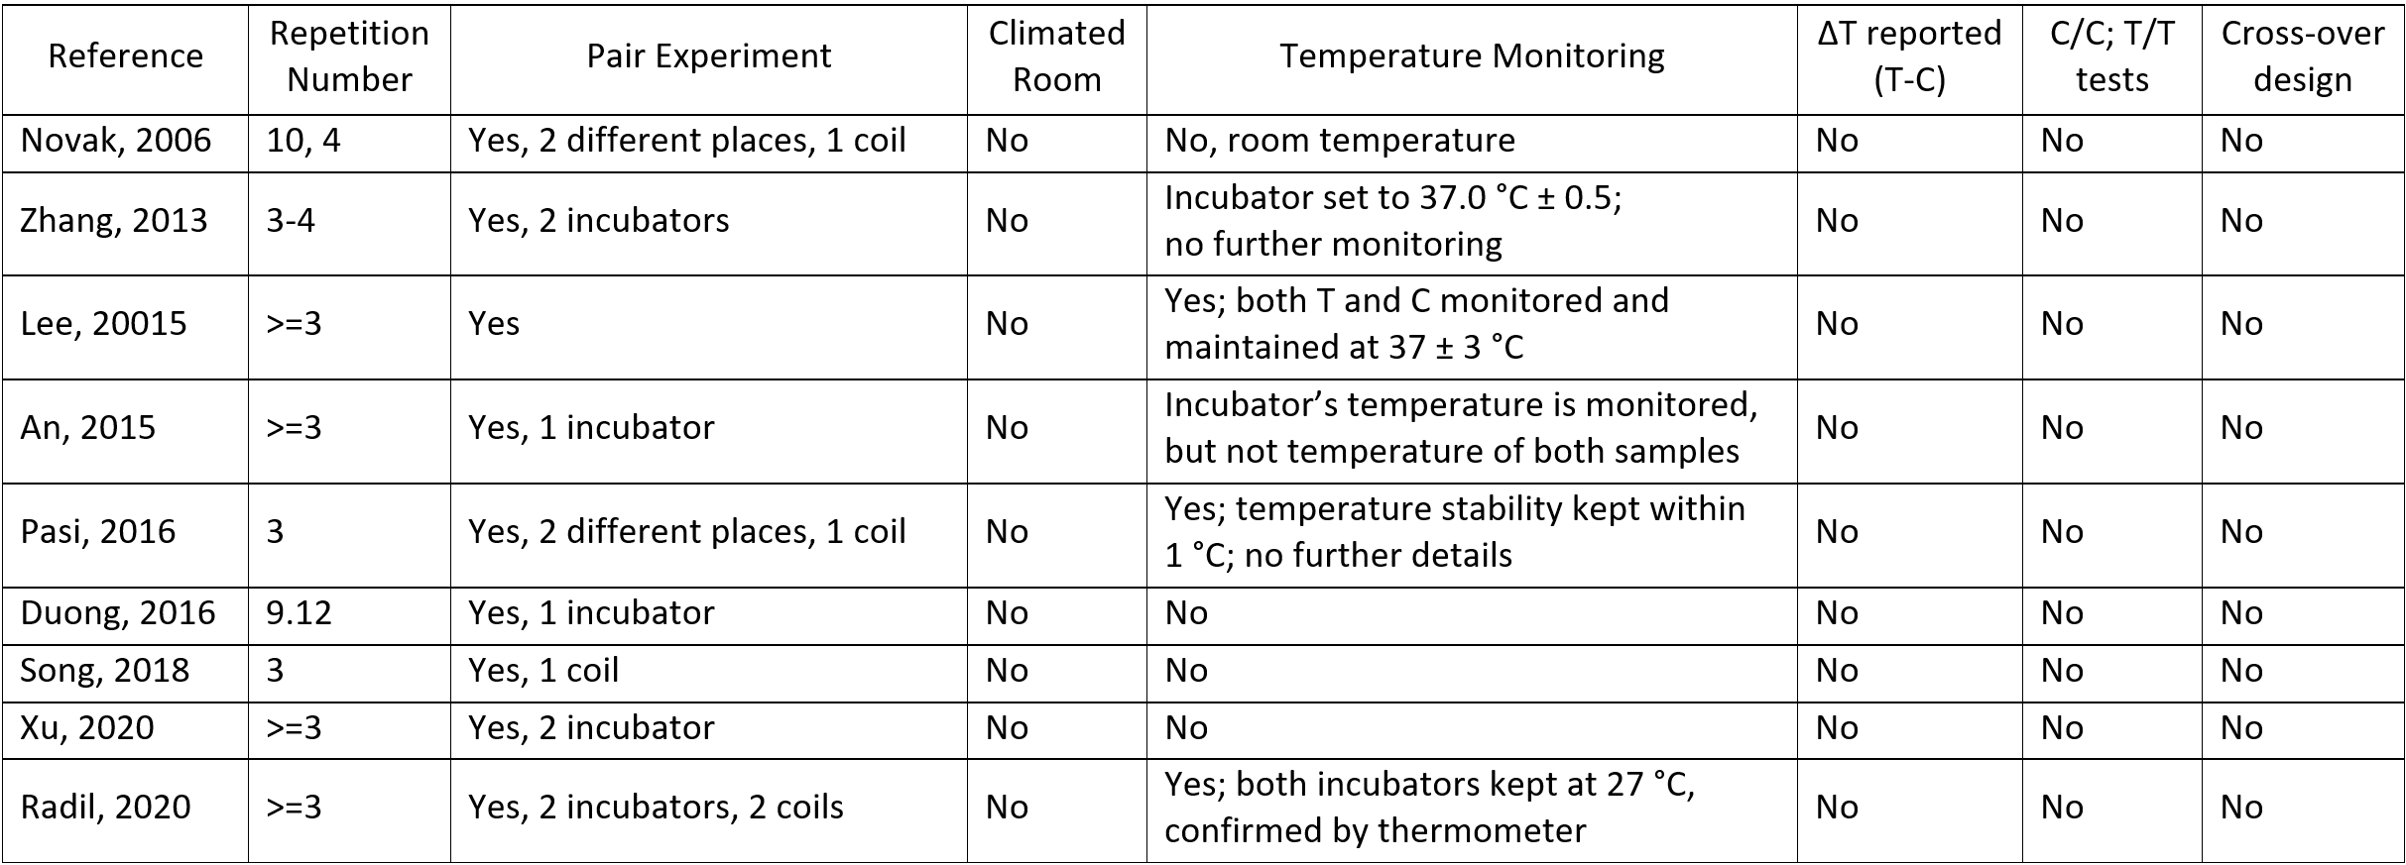
Previous Researches – Measurement Setup

Slide 6
Measurement Platform

Slide 7
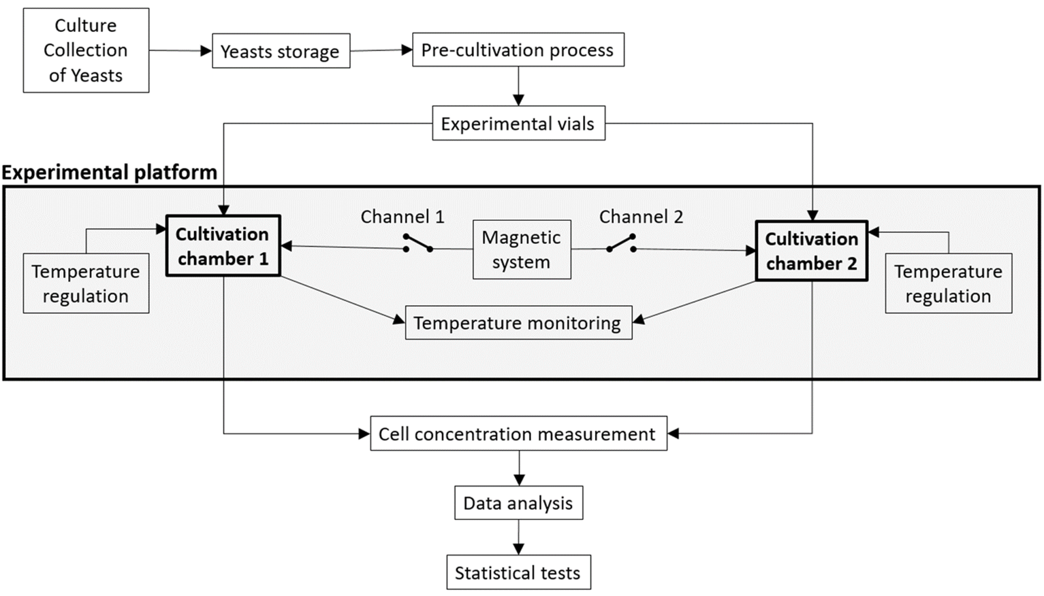
Measurement Platform Workflow

Slide 8
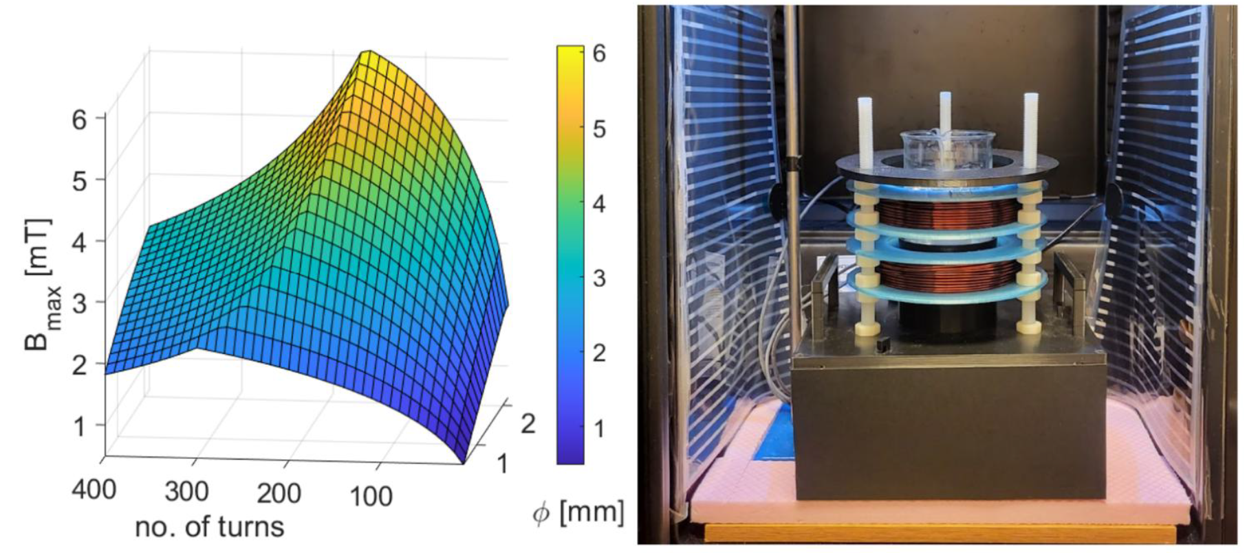
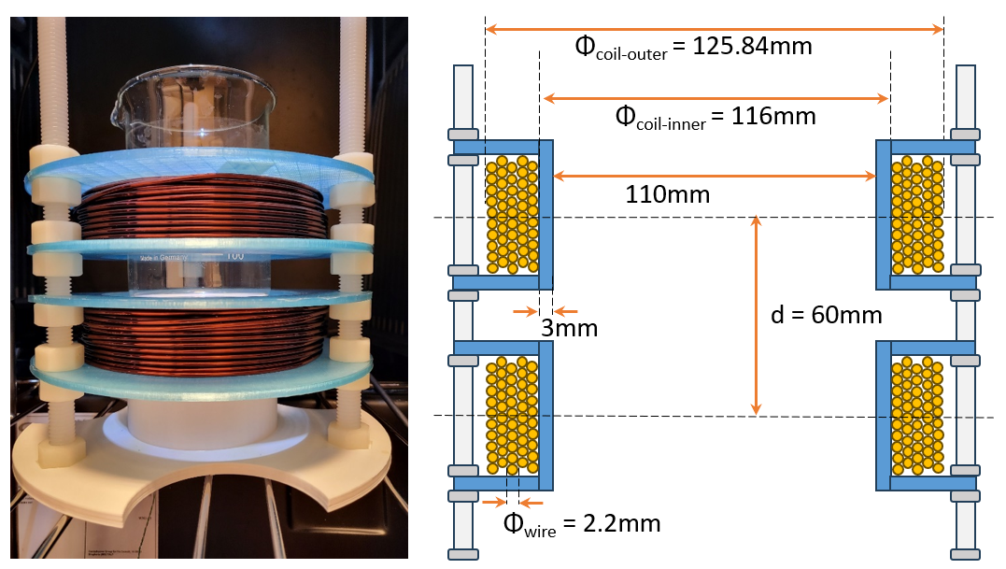
Helmholtz Coils – Matlab Simulation
Number of turn increases -> resistance and inductive reactance rise -> reducing current at given voltage and limiting the magnetic flux density.
the increase in coil turns -> drop in field due to heat and voltage limits
The parameters of coils (coil diameter, wire diameter, number of turns, and number of wire layers) were optimized while constraining the internal heat generation of the coils below 2 W
2.2 mm copper wire
2x50 turns (5 layers with 10 turns per layer)
Length 34.5 m
Inner diameter 116 mm
Outer diameter 125.84 mm

Slide 9
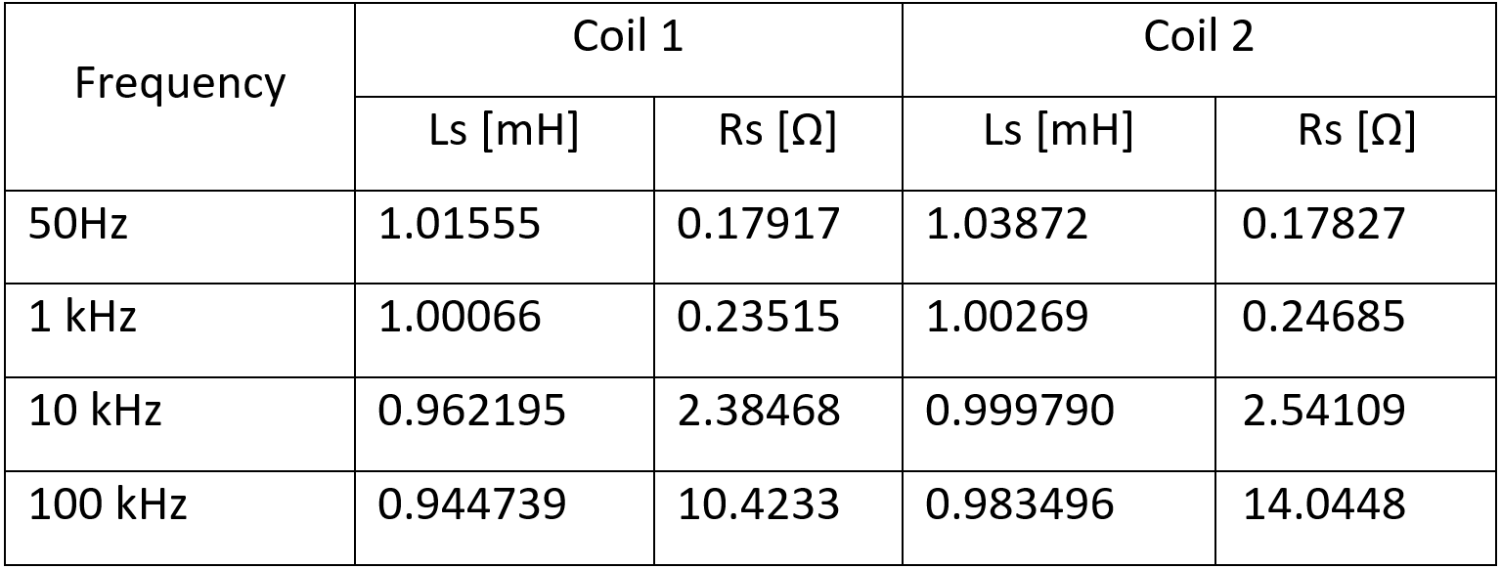
Helmholtz Coils
The DCR is consistent with expectations due to additional resistance from solder joints, connector terminals, and measurement tolerance
The small difference between the inductance of Coil 1 and Coil 2, generally under 3%, suggests a high level of symmetry and consistency in the winding and construction
 | DCR | L
Simulated | - | 774 µH
Calculated | 0.152 Ω | 886 µH
Measured Coil 1 | 0.1851 Ω | ~1 mH
Measured Coil 2 | 0.1968 Ω | ~1 mH

Slide 10
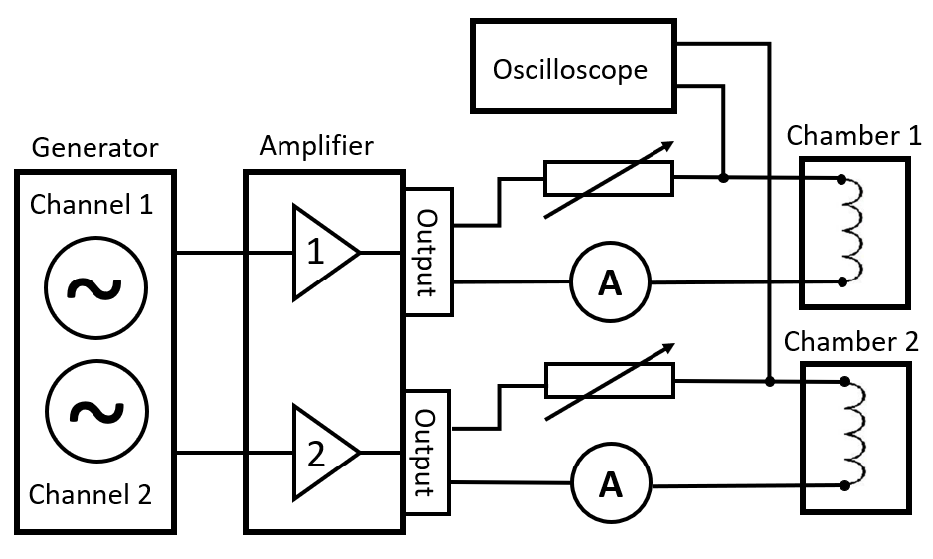
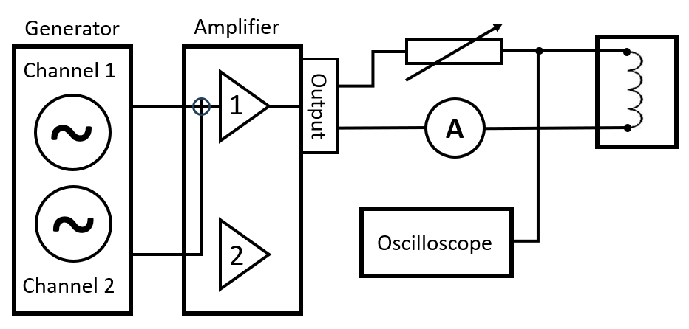
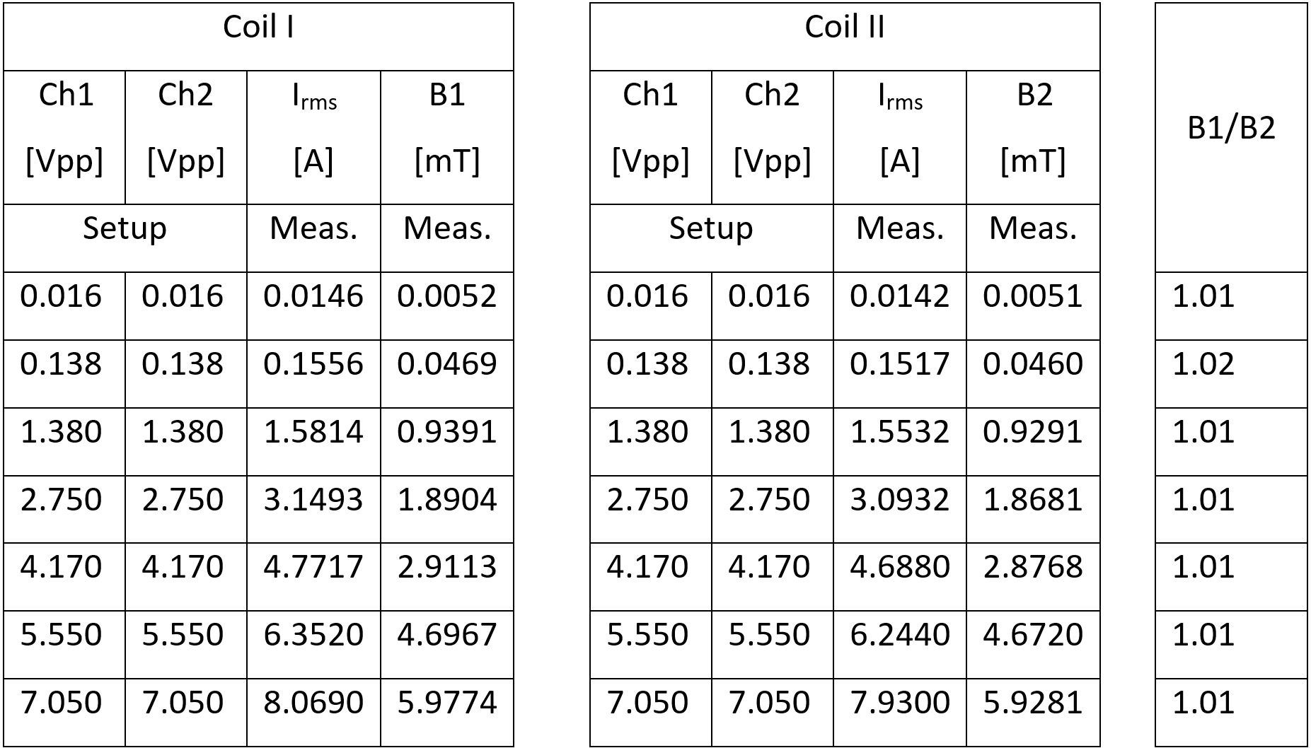
System for Magnetic Field Generation
In pair experiments, the magnetic field generated inside two cultivation chambers should be identical.
Measured magnetic flux densities generated inside two chambers at 800 Hz (XL = 5.027 Ω)
The resulting ratio of two magnetic flux densities is close to 1.01, the difference is below 2 %.

Slide 11
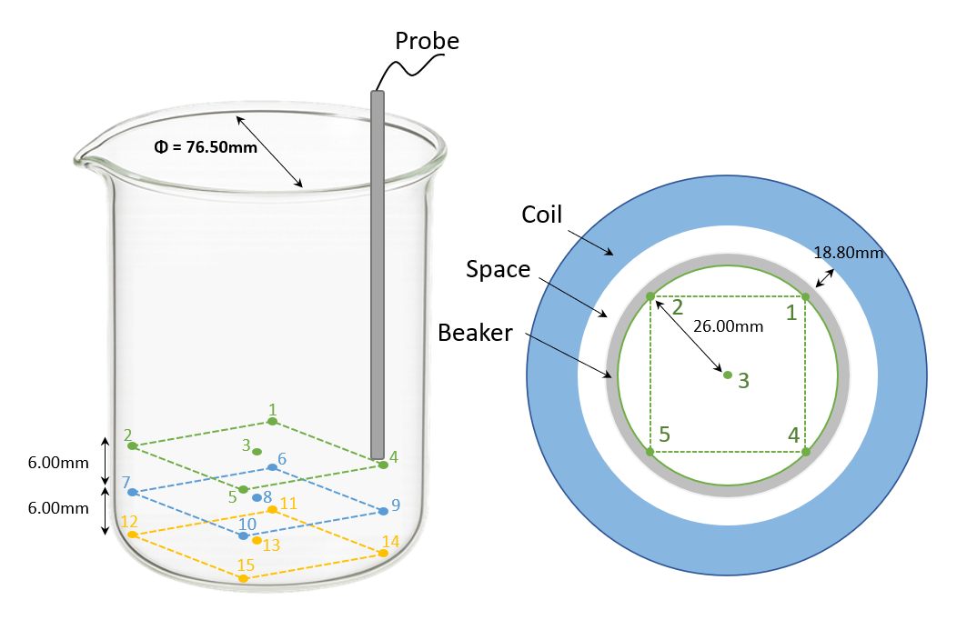
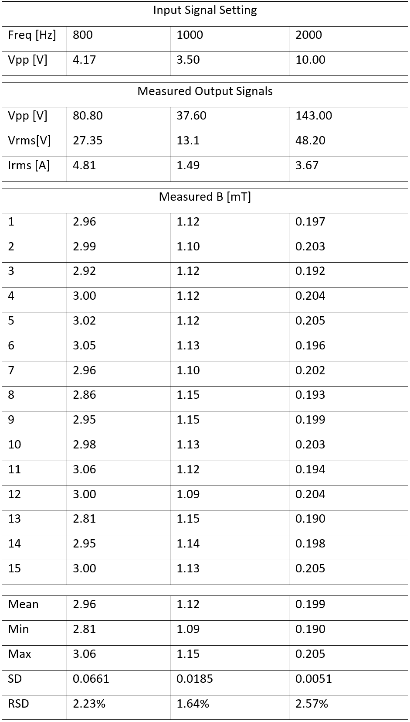
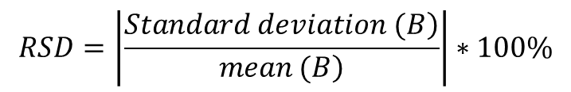
Homogeneity of Magnetic Field
Frequency [Hz] | RSD [%]
800 | 2.23
1000 | 1.64
2000 | 2.57
$$RSD=\left|\frac{\left.Standard deviation (B\right)}{\left.mean (B\right)}\right|∗100\%$$
The relatives standard deviation ranging between 1.64% and 2.57% demonstrate that the system provides sufficiently homogeneous conditions

Slide 12
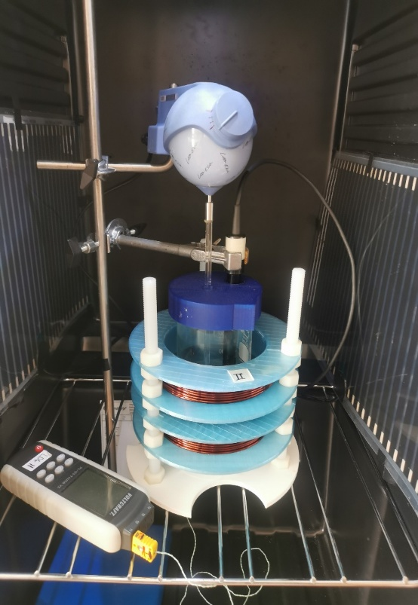
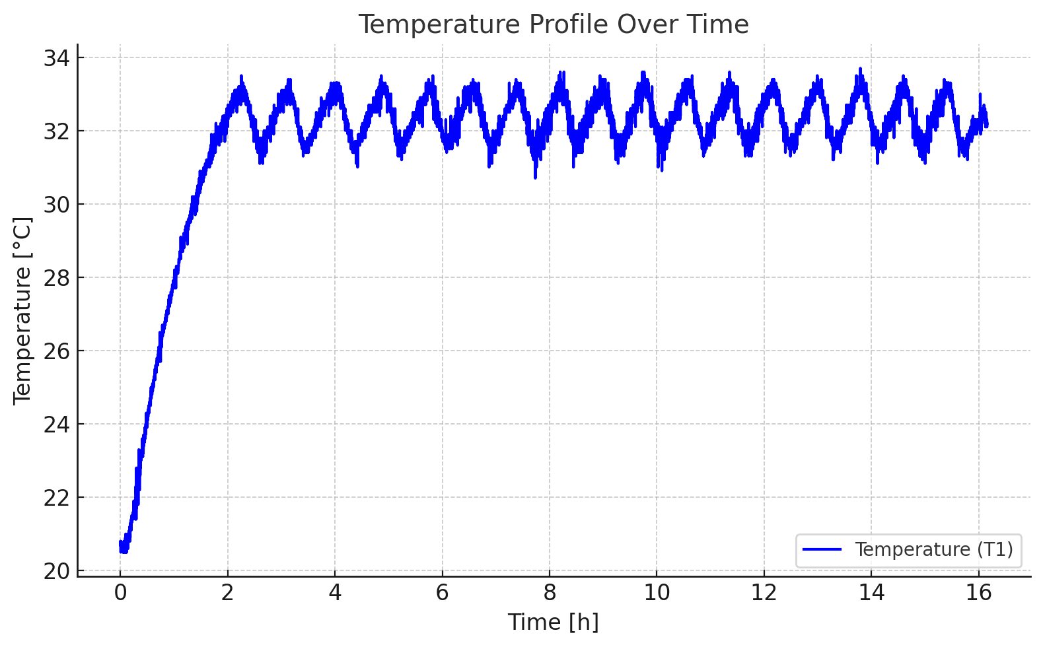
Temperature Regulation in Cultivation Chamber
Previous system:
on-off temperature controller
temperature data logger equipped with a K-type thermocouple sensor
Temperature fluctuated min 30.7 °C - max 33.7 °C
Total spread of 3.0 °C and standard deviation of 0.54 °C
Upgraded system:
PID temperature controller
In-situ temperature monitoring using Arduino with digital temperature sensors
3D printed stand provided consistent positioning
Typical temperature variation within ±0.3 °C
Worst-case deviations not exceeding ±0.5 °C

Slide 13
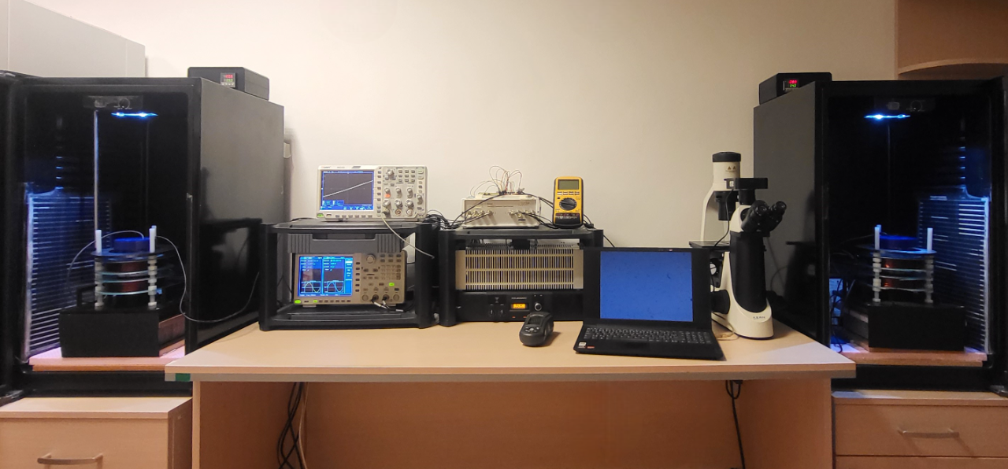
The Completed Measurement Platform

Slide 14
Experiments

Slide 15
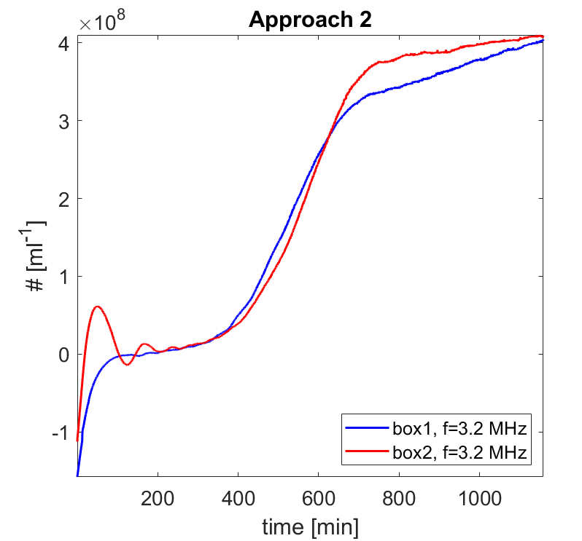
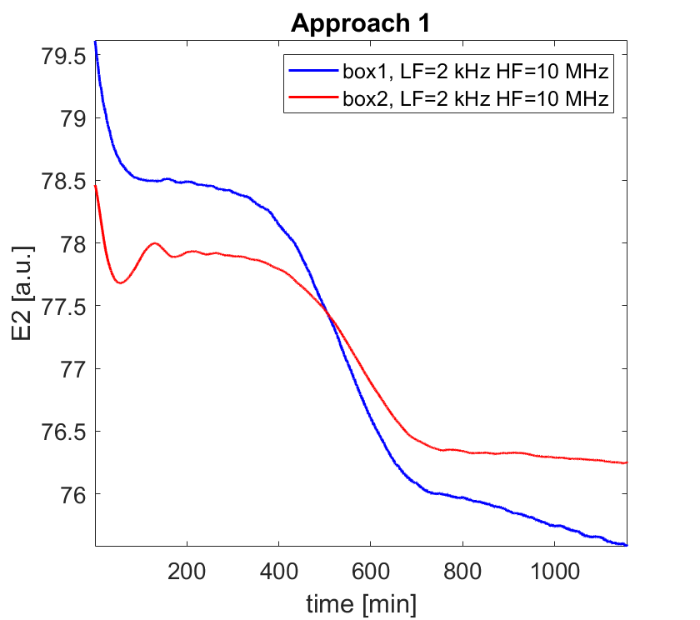
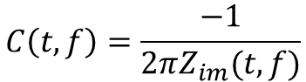
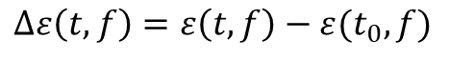
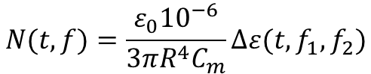
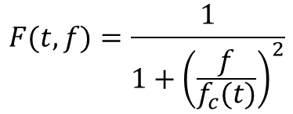
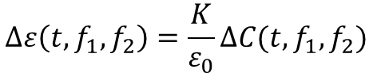
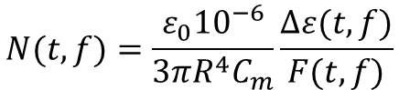
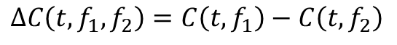
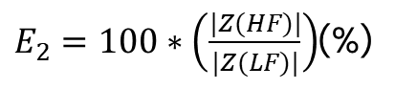
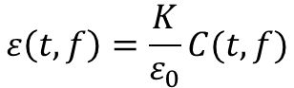
Cell Concentration Monitoring Based on Impedance Spectroscopy
*Asami, K. and Yonezawa, T.: Dielectric analysis of yeast cell growth, Biochimica et Biophysica Acta 1245: 99-105, 1995.
*Yardley J.E., et al.: On-line, real-time measurements of cellular biomass using dielectric spectroscopy. Biotechnol Genet Eng Rev. 17:3-35, 2000.
*Soley A. et al.: On-line monitoring of yeast cell growth by impedance spectroscopy, Journal of Biotechnology 118, 398–405, 2005
$$C\left(t,f\right)=\frac{−1}{{2πZ}_{im}(t,f)}$$
$$ε\left(t,f\right)=\frac{K}{ε_{0}}C(t,f)$$
$$∆C\left(t,f_{1},f_{2}\right)=C\left(t,f_{1}\right)−C\left(t,f_{2}\right)$$
$E_{2}=100∗\left(\frac{|Z(HF)|}{|Z(LF)|}\right)$(%)
$$∆ε\left(t,f\right)=ε\left(t,f\right)−ε(t_{0},f)$$
$$F(t,f)=\frac{1}{1+{\left(\frac{f}{f_{c}(t)}\right)}^{2}}$$
$$∆ε\left(t,f_{1},f_{2}\right)=\frac{K}{ε_{0}}∆C(t,f_{1},f_{2})$$
where:
|Z(LF)| - the impedance magnitude at low-frequency (f ≪ fc)
|Z(HF)| - the impedance magnitude at high-frequency (f ≫ fc)
fc - central frequency
$$N(t,f)=\frac{ε_{0}{10}^{−6}}{{3πR}^{4}C_{m}}\frac{∆ε(t,f)}{F(t,f)}$$
$$N(t,f)=\frac{ε_{0}{10}^{−6}}{{3πR}^{4}C_{m}}∆ε(t,f_{1},f_{2})$$

Slide 16
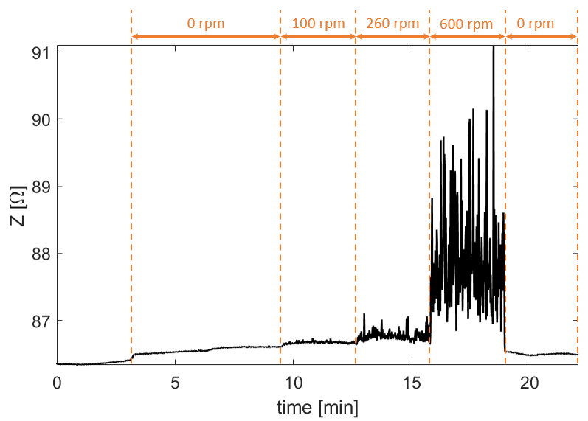
Interference of Mechanical Vibration with Impedance Measurement
Mechanical vibrations from the stirrer significantly affect impedance readings: increasing both average impedance and noise levels with rising RPM (+1.43% increase at 600 rpm).
Optimal compromise at 200 rpm ensuring effective sample mixing while minimizing measurement noise, enhancing the stability of real-time impedance monitoring.

Slide 17
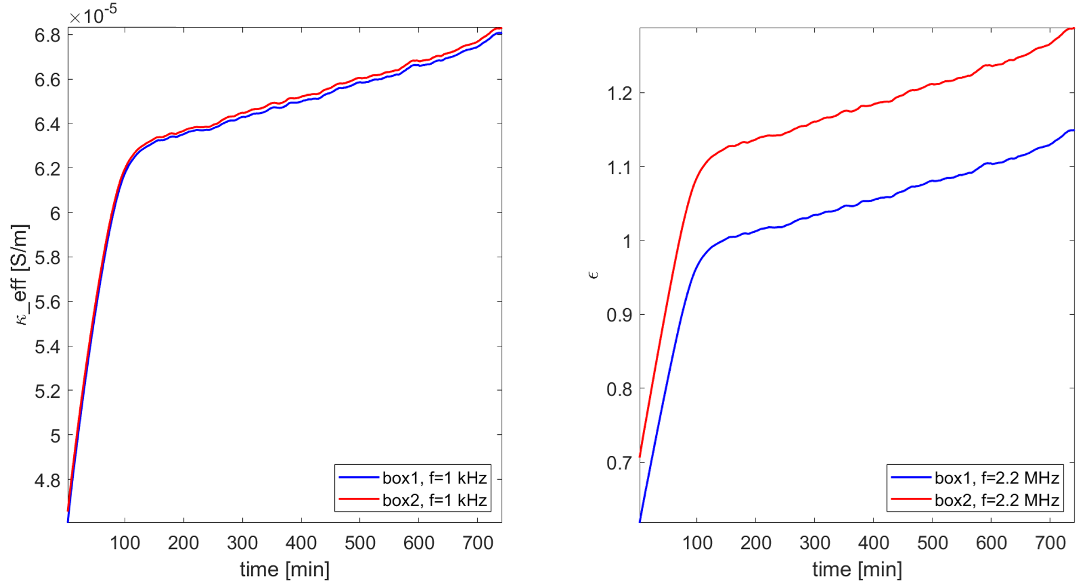
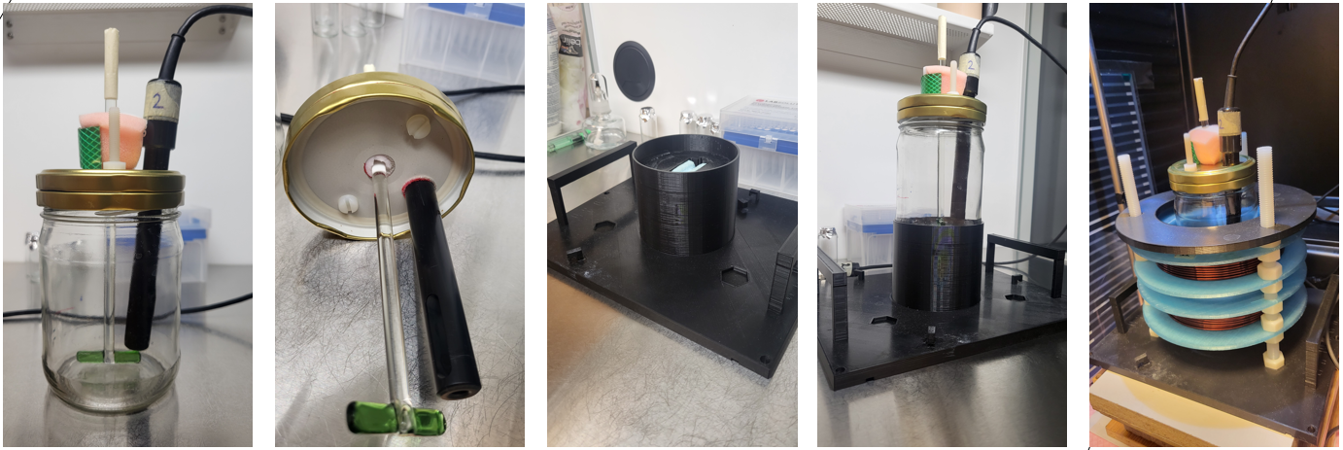
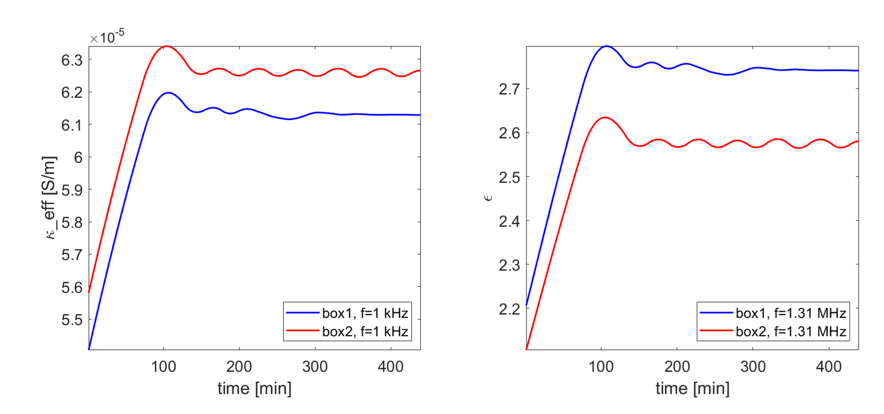
Improvement of the Measurement Conditions Using Bioreactor
Before:
After:
A sealed bioreactor system was developed to eliminate evaporation artifacts and reduce contamination risks, enabling stable long-term impedance measurements.
This improvement significantly enhanced measurement accuracy, precision, and reproducibility ensuring that observed changes are due to biological effects rather than environmental variability.

Slide 18
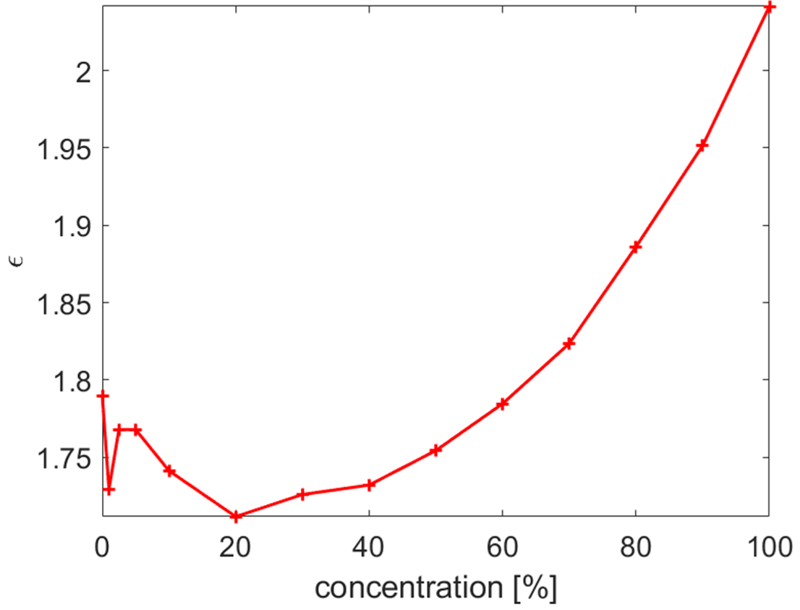
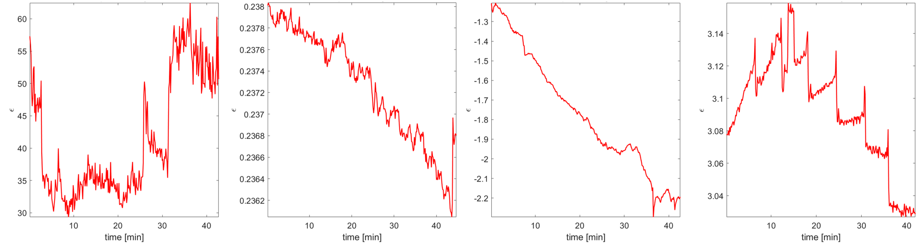
Challenges in Impedance-Based Real-Time Concentration Monitoring
A calibration curve was constructed using 14 samples with known cell concentrations (100% to 0%), measuring permittivity at 1.31 MHz based on the Asami & Yonezawa model
While permittivity generally increased with concentration, values below 20% showed large fluctuations, and some exceeded readings at 60%, indicating unreliable calibration at low concentrations
Permittivity was measured using five different electrode types during stepwise yeast cell additions into YPD, covering diverse probe geometries, wiring setups, and materials
Despite variations in permittivity scales, none of the probes showed a clear trend correlating with increasing cell concentration, confirming the limitation lies in the measurement principle, not electrode design

Slide 19
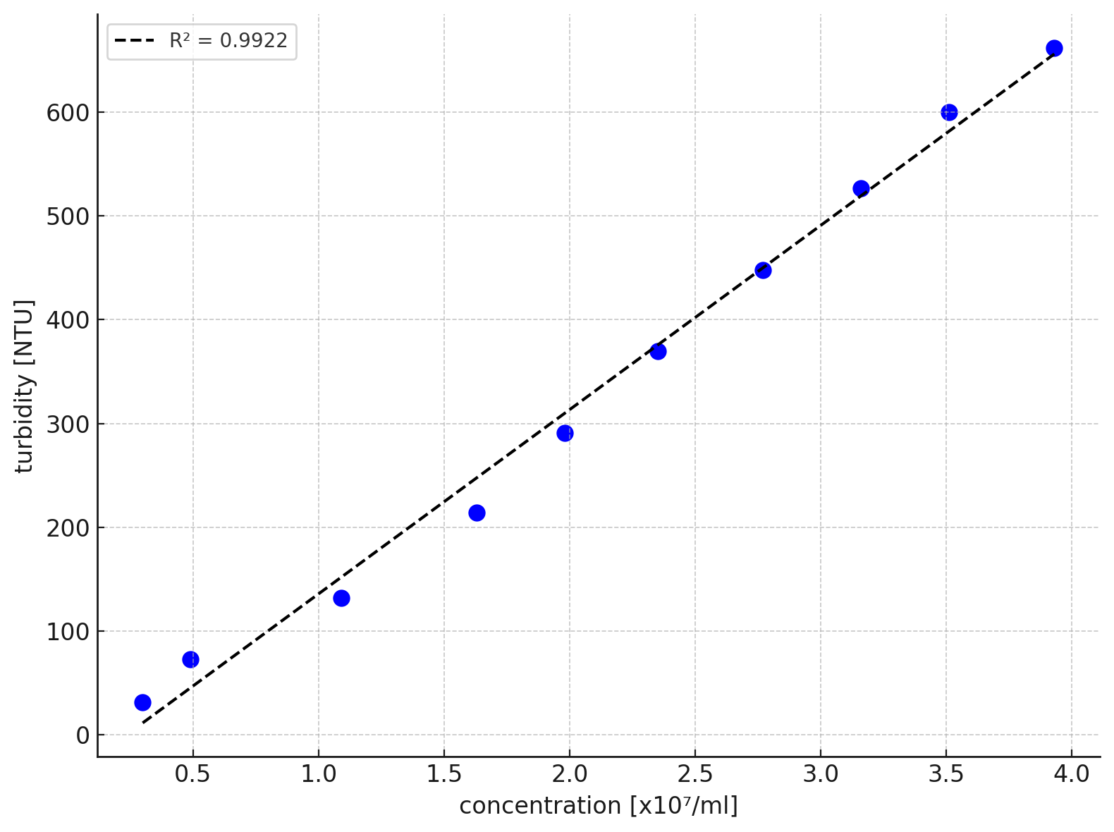
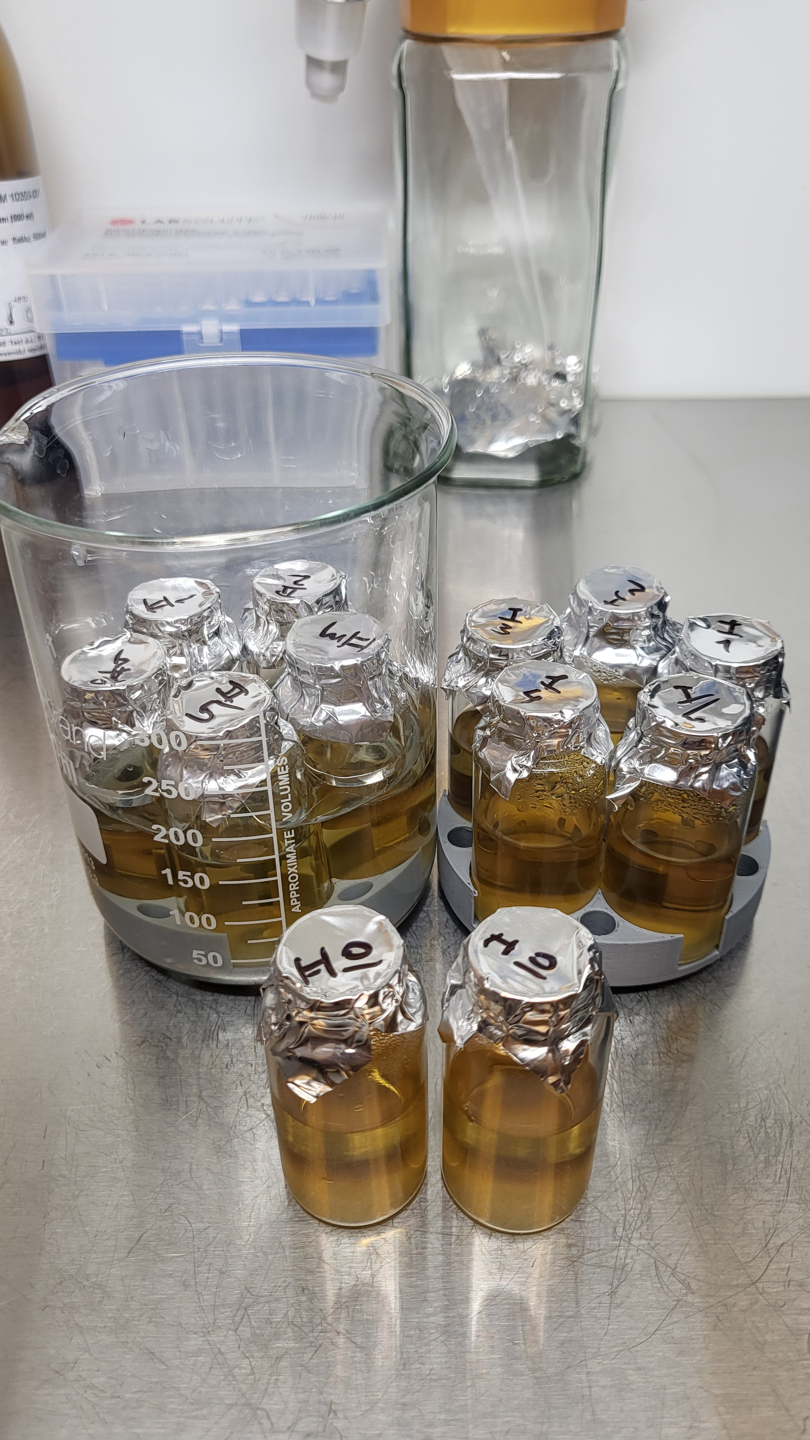
Static Cultivation with Turbidimetry-Based Concentration Measurement
Minimalistic configuration:
no stirring
no impedance probe
A total of 12 vials:
5 test samples exposed to LF MF
5 control samples not exposed to LF MF
2 dilution control vials were prepared with a 10× dilution to serve as a reference
Improved sterility control, achieved by using sealed vials and avoiding unnecessary instrumentation.
A dilution series of yeast culture in YPD medium was prepared
each dilution was measured both by a turbidimeter and hemocytometer
The resulting dataset showed a strong linear relationship between turbidity and cell concentration with a coefficient of determination of 0.9913
Indicating an excellent fit and high predictive accuracy of the model

Slide 20
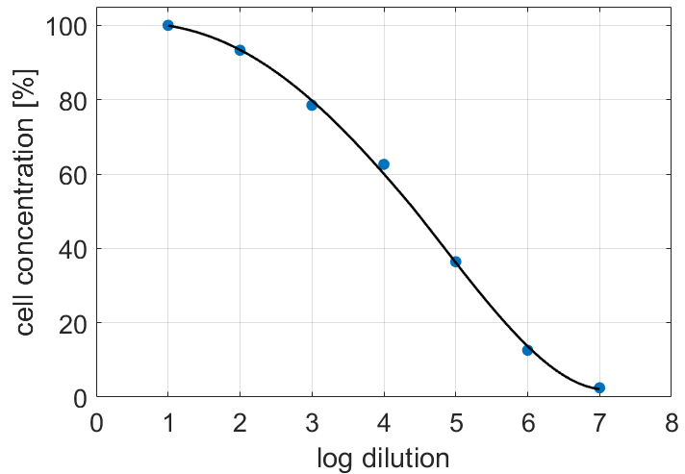
Optimization for Starting Microbial Concentration
Biomass growth was assessed after 20 hours of stationary cultivation at 35 °C using various dilutions of S. cerevisiae pre-culture, with turbidity used as the measurement method
Initial inoculum (5.5x10⁷ cells/ml)
Dilutions ranged from 1:10 to 1:10⁷, revealing that growth dropped sharply beyond a 1:3.2×10⁴ dilution, with minimal growth (2.2%) at 1:10⁷
The optimal dilution for target biomass growth (20–60%) was found to be approximately 1.8×10⁵-fold, corresponding to ~306 cells/ml
Vu Viet H., Kremnicky L., Bereta M., Teplan M. (2025). Experimental Platform for Investigation of Low-Frequency Magnetic Field Effects on Cells. Measurement Science Review, 25 (2), 83-92

Slide 21
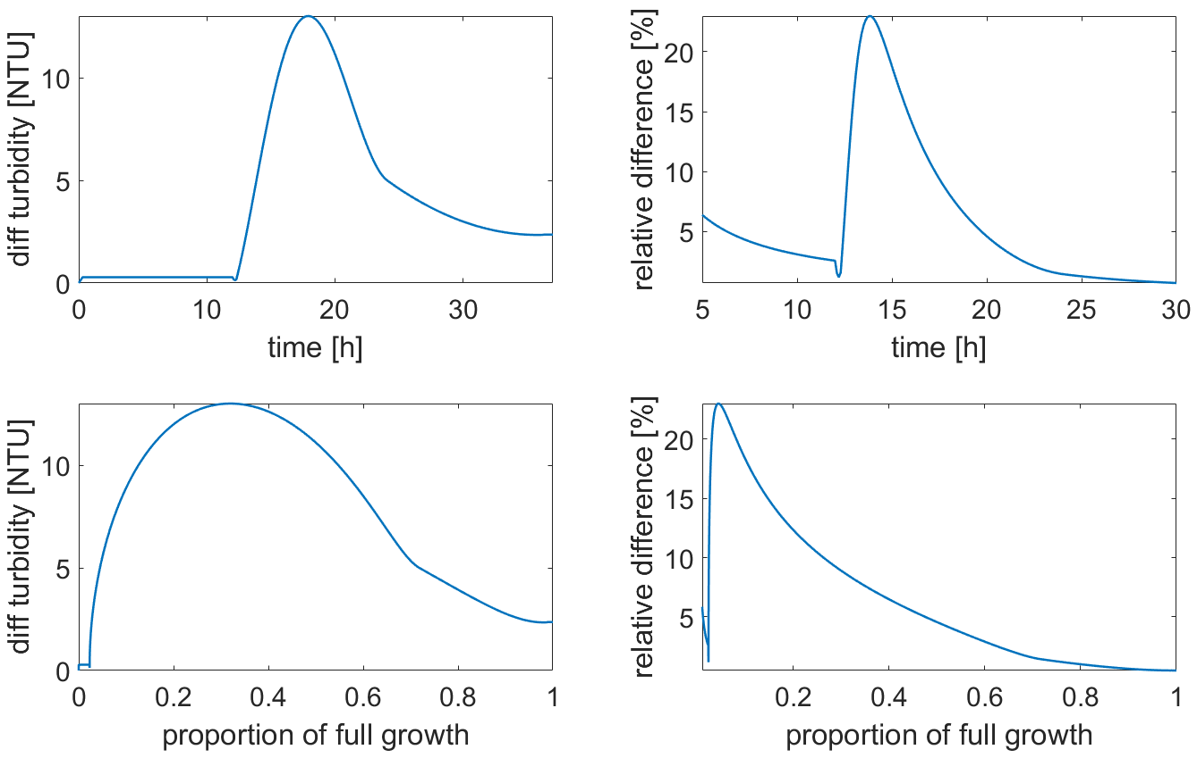
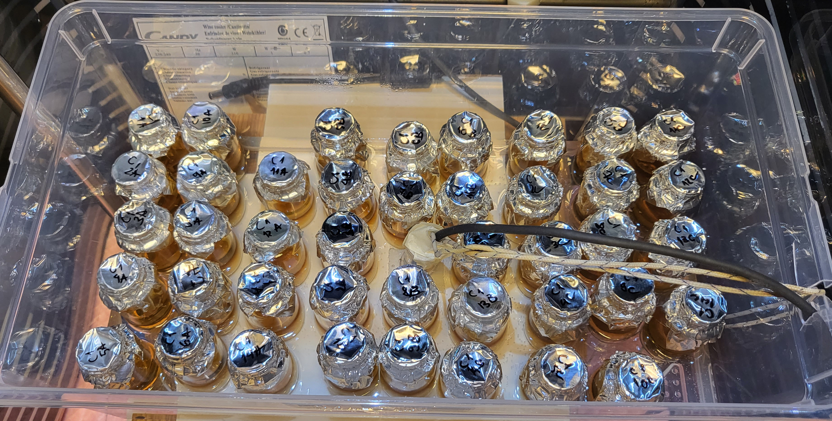
Optimization for Experiment Duration
Experiment setup: Growth curves were created by monitoring biomass in 84 vials with synchronized cultivation in two temperature-controlled chambers; yeast concentration was measured at 14 time points from 12 to 37 hours
Simulation: A modeled magnetic field (MF) effect was simulated by shifting the growth curve in time (±2 hours), allowing prediction of the best time to observe differences between control and MF-exposed samples
Selection criteria: The goal was to choose a time point with both high absolute difference between growth curves and reliable turbidity/manual count precision
Result: The 18th hour was selected as optimal, corresponding to ~33% of maximum biomass (~1.82×10⁷ cells/ml), balancing detectability and measurement reliability

Slide 22
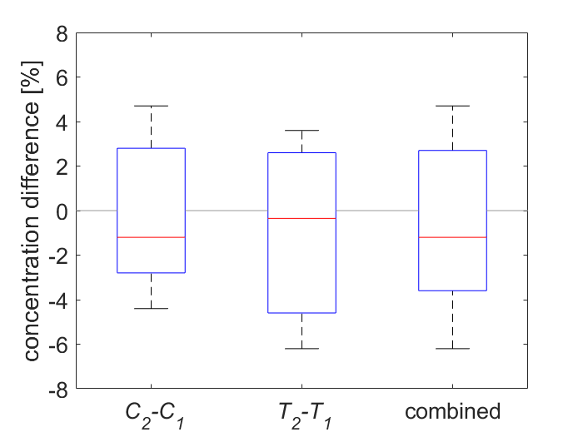
Verifying Pair Experimental Design
In all three cases:
the mean difference in cell growth between the two chambers remained below 1%.
Statistical analysis using a one-sample t-test did not reject the hypothesis that the mean values of these sets were equal to zero (p-values = 0.56, 0.78, and 0.52).
These findings indicate that the two chambers provide sufficiently consistent conditions for cell growth within the given experimental settings.
C2-C1: both chambers in control mode without MF
T2-T1: both chambers in test mode with MF
Combined: merged data from the two sets
The pair experiment was conducted over 18 hours, with five test sample vials placed in each chamber and operated under two modes:
both chambers under control conditions without MF (N=5)
both chambers exposed to a 50 Hz MF of 3.5 mT driven by an electrical current of 4.5 A (N=5).
Throughout the experiment, the temperature in both cultivation chambers was maintained at 35 °C.
Vu Viet H., Kremnicky L., Bereta M., Teplan M. (2025). Experimental Platform for Investigation of Low-Frequency Magnetic Field Effects on Cells. Measurement Science Review, 25 (2), 83-92

Slide 23
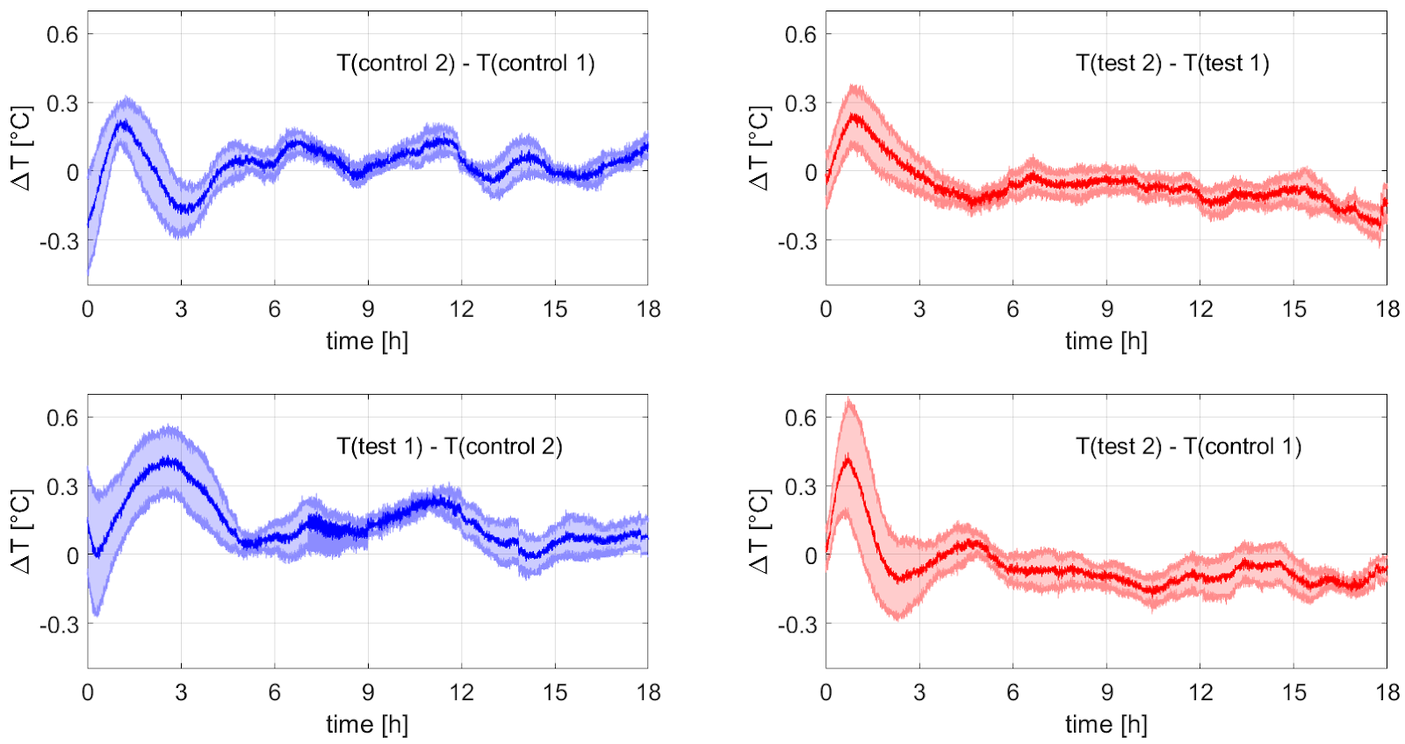
Effect of 50 Hz Magnetic Field – Temperature Conditions
Data from four types of pair experimental setups (chamber assignment order relevant in the latter two cases)
control vs. control (N=6)
test vs. test (N=6)
test vs. control (N=6)
control vs. test (N=6)
To ensure reliable comparisons, only those experiments that met strict thermal criteria were included in the final analysis:
the mean temperature in both chambers had to be within 35 ± 0.3 °C
the inter-chamber temperature difference had to remain within ±0.3 °C
Of the 58 total experimental runs, 24 fulfilled these criteria
Notes:
Ziadne literatury taketo veci neriesili

Slide 24
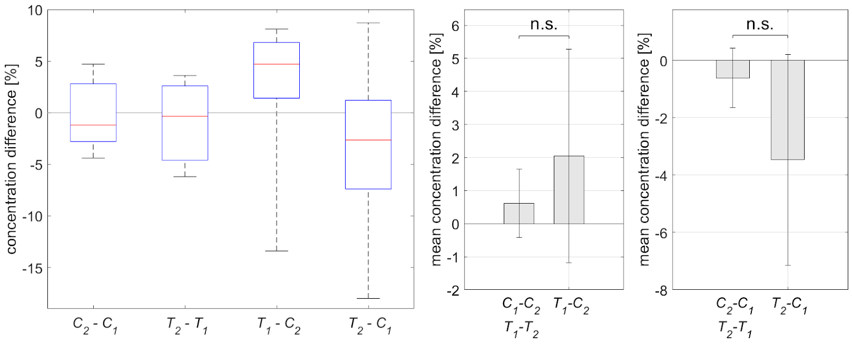
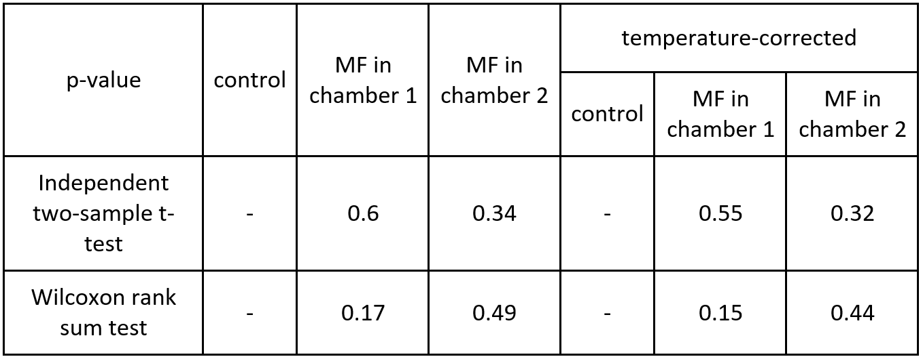
Effect of Magnetic Field on Saccharomyces Cerevisiae Growth
50 Hz, 3.5 mT
No consistent MF effect detected: growth increased slightly in chamber 1 (+1.4%) and decreased in chamber 2 (–2.8%) under MF, but the opposing signs contradict a genuine MF effect
No statistical significance: all tests (t-test, Wilcoxon) showed p > 0.05
Variables were tightly controlled: pair design, temperature monitoring, and multiple analyses were applied
Earlier studies may have lacked control: temperature differences likely caused false positives
Study strengthens the evidence for null effect: Under strict conditions (35 ± 0.3 °C), no measurable biological response to LF-MF was observed

Slide 25
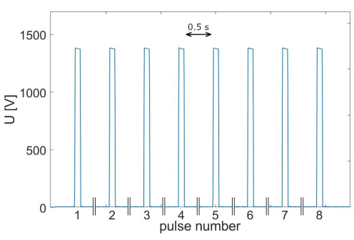
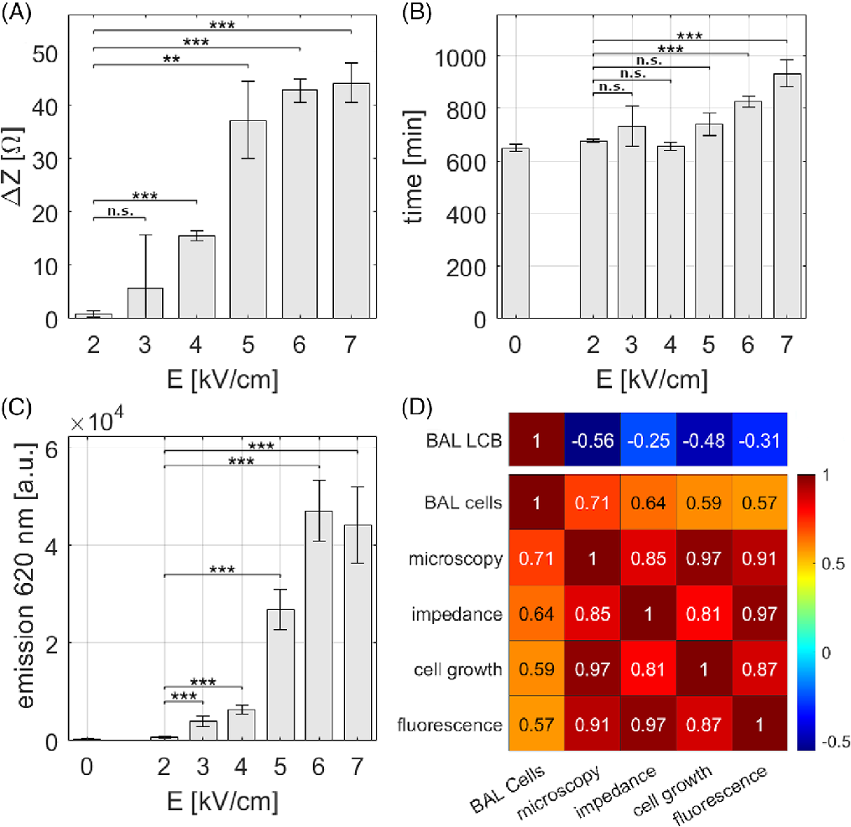
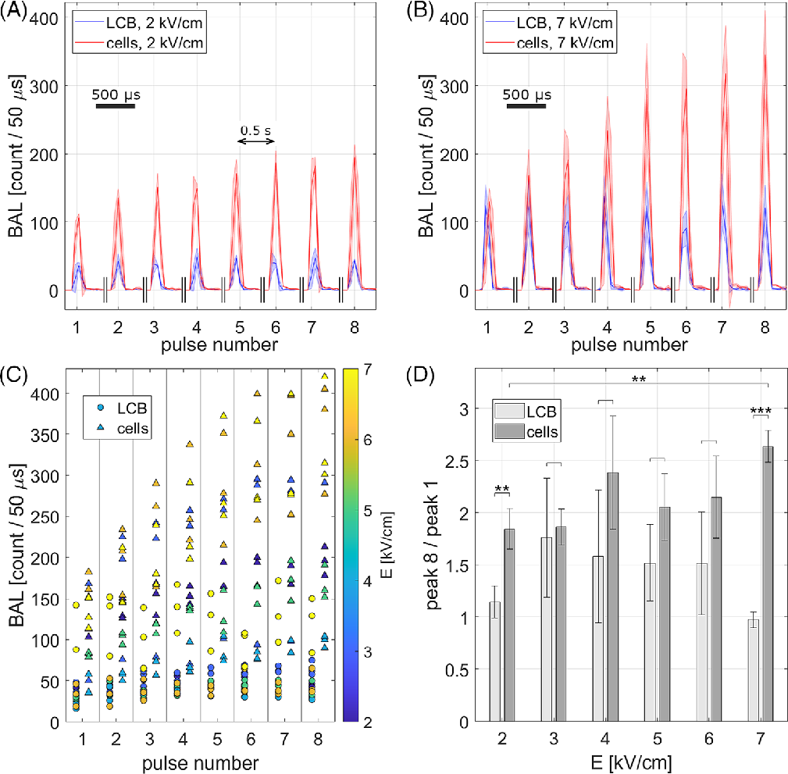
Pulsed Electric Field Effect on Yeast Cells Measured by Autoluminescence and Impedance Measurements
Biological autoluminescence (BAL) measurements revealed a significant increase in light emission intensity starting at 6–7 kV/cm, with higher BAL ratios observed after repeated PEF pulses
Indicating membrane stress and potential electroporation effects.
The applied electric field consisted of 8 rectangular pulses at 1400 V (7 kV/cm), each lasting 100 µs and spaced by 0.5 s, ensuring controlled and reproducible PEF exposure
Impedance spectroscopy detected a significant increase in ΔZ starting at 5 kV/cm
Indicating enhanced membrane permeability due to electroporation; the rise in impedance reflects intracellular ion leakage into the medium following PEF exposure.
Bereta M., Teplan M., Zakar, T., Vu Viet H., Cifra M., Chafai D.E. (2024). Biological Autoluminescence Enables Effective Monitoring of Yeast Cell Electroporation. Biotechnology Journal, 19 (4), 2300475

Slide 26
Conclusions and Main Contributions
Comprehensive review of current LF MF research, highlighting inconsistencies and experimental limitations in previous studies
Design and validation of a modular experimental platform for LF MF exposure with improved design of Helmholtz coils (MF inhomogeneity: 2.6%), MF generation system (ratio of MF between 2 chambers: 1.01), and thermal regulation (±0.3 °C) for pair experimental design
Development of impedance spectroscopy integration for real-time, in-situ monitoring of cell concentration, including evaluation with three approaches of concentration estimation methods. Despite the inconsistency of the result, the method proved promising in a separate study, indicating potential for future refinement
Selection of turbidimetry as the primary cell growth estimation method due to its reliability and ease of use for designed experimental platform
Experiment with yeast cells under 50 Hz, 3 mT LF MF revealed no statistically significant effect
Establishment of a robust methodological framework for future LF MF research, providing a basis for future studies with potential applications in biotechnology, diagnostics, and medicine

Slide 27
Author’s Publications
Publications in scientific journals:
Vu Viet H., Kremnicky L., Bereta M., Teplan M. (2025). Experimental Platform for Investigation of Low-Frequency Magnetic Field Effects on Cells. Measurement Science Review, 25 (2), 83-92. http://doi.org/10.2478/msr-2025-0011
Bereta M., Teplan M., Zakar, T., Vu Viet H., Cifra M., Chafai D.E. (2024). Biological Autoluminescence Enables Effective Monitoring of Yeast Cell Electroporation. Biotechnology Journal, 19 (4), 2300475, https://doi.org/10.1002/biot.202300475
Publications in conference proceedings:
Teplan, M., Vu Viet, H., Kremnicky, L., Bereta, M. (2025). Growth of Saccharomyces Cerevisiae in a 50 Hz Magnetic Field. MEASUREMENT 2025: Proceeding of the 15th International Conference on Measurement, 19-22, ISBN 978-80-69159-01-3, https://doi.org/10.23919/MEASUREMENT66999.2025.11078695
Vu Viet H., Teplan M., Kremnicky L., Bereta M. (2025). Optimization of Physical and Biological Parameters for Studying Microorganism Responses to Low-Frequency Magnetic Fields. MEASUREMENT 2025: Proceeding of the 15th International Conference on Measurement, 245-248, ISBN 978-80-69159-01-3, https://doi.org/10.23919/MEASUREMENT66999.2025.11078721
Vu Viet, H., Teplan, M. (2023). Development of An Experimental Platform for The Measurement of Biological Response of Low-Frequency Magnetic Fields. MEASUREMENT 2023: Proceeding of the 14th International Conference on Measurement, 113-116, ISBN 978-80-972629-7-6, https://doi.org/10.23919/MEASUREMENT59122.2023.10164326
Bereta, M., Teplan, M., Chafai D.E., Zakar T., Vu Viet H., Cifra M. (2023). Assessment of Yeast Cells Electroporation by Autoluminescence and Impedance Measurements. MEASUREMENT 2023: Proceeding of the 14th International Conference on Measurement, 109-112, ISBN 978-80-972629-7-6, https://doi.org/10.23919/MEASUREMENT59122.2023.10164612
Vu Viet H., Teplan M. (2021). Impact of Magnetic Field on Yeast Cells Monitored by Impedance Spectroscopy. IWIS 2021: Proceeding of International Workshop on Impedance Spectroscopy, 85-88, ISBN 978-1-6654-9472-4, https://doi.org/10.1109/IWIS54661.2021.9711789
Teplan M., Vu Viet H., Bereta M., Bajla I. (2021). Measurement System for Monitoring of Magnetic Field Effects on Yeast Cells by Impedance Spectroscopy. MEASUREMENT 2021: Proceeding of the 13th International Conference on Measurement, 198-201, ISBN 978-80-972629-5-2, http://doi.org/10.23919/Measurement52780.2021.9446776

Slide 28
THANK YOU
For your attention

